Slide 1
Multi Leader Replication

Slide 2
Types of replication
Single leader
Multi leader
Leaderless

Slide 3
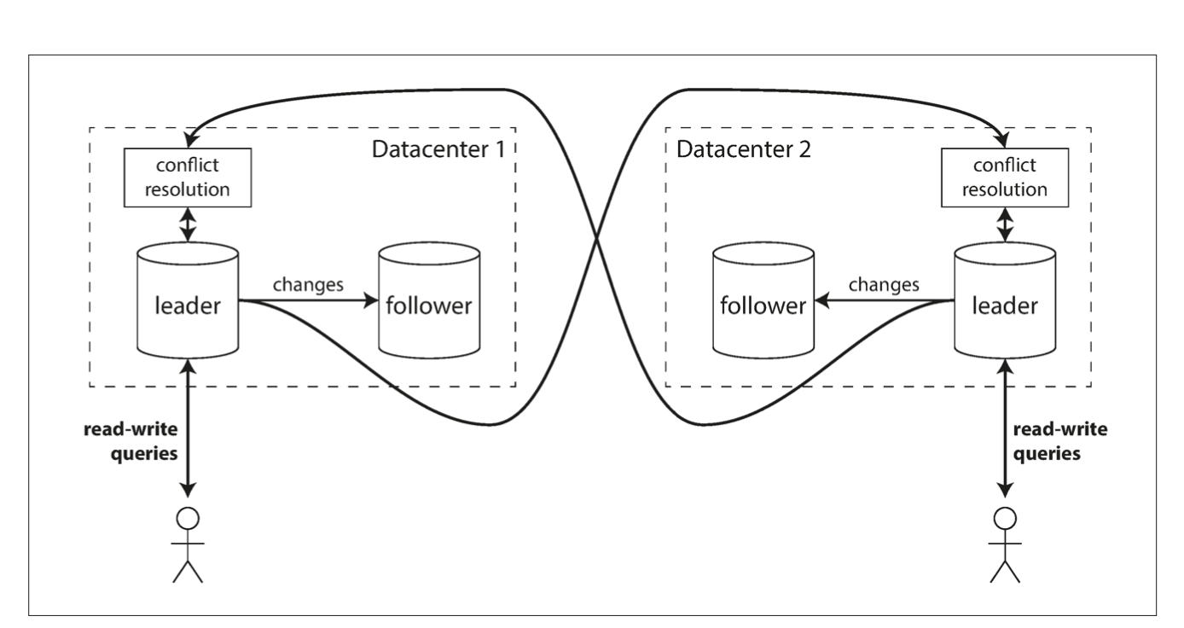
Multi Leader Replication Overview
Multiple leader database, possibly across data centers
Leader databases send each other writes through some pre-existing topology
Reads can come from any database

Slide 4
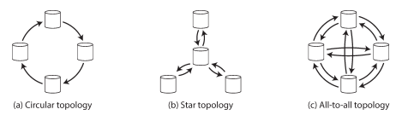
Multi Leader Replication Topologies

Slide 5
Multi Leader Replication Topologies
Circle and star topologies can easily fail (any node crash for circle, central node crash for star)
All to all topology can have writes delivered out of order due to race condition

Slide 6
Multi Leader Replication Tradeoffs
Pros:
Can have a leader in each data center, makes having a global service more manageable (outages between datacenters do not break application)
Are not limited to the write throughput of a single node
Cons:
Having to deal with write conflicts between multiple leaders

Slide 7
Conflict Resolution
Conflict Avoidance
Last Write Wins
On read
On write

Slide 8
Conflict Avoidance
The easiest way to deal with conflicts is to just avoid them
Have all writes to the same item go to a given leader
Not always possible if leader is down or you want to change your database configuration

Slide 9
Last Write Wins
Each write is assigned a timestamp, write with latest timestamp is kept
Pros:
Very easy to implement
Cons:
Do we use the client or the server timestamp?
Writes will be lost
Clock skew on servers means that their times are not exactly synchronized

Slide 10
On read
When database detects concurrent/conflicting writes, store both writes
Return both values to a user on the next read to manually merge the values and store the resulting merged value in the database

Slide 11
On write
When database detects concurrent writes, call snippet of code to merge them somehow (often application specific)
This is the idea between conflict free replicated data types

Slide 12
Detecting Concurrent Writes
Two writes are concurrent if each client did not know about the write of the other when they made the write, has nothing to do with actual time of write.
If one client knew about the write of the other, we would have a causality relationship between the two.
Hence, detecting concurrent writes is all about keeping track of what a client has seen from the database before making a write.

Slide 13

Version Vectors
For each key: keep track of an increasing version number for each key for each replica
Client 1
Replica A
Replica B
Client 2

Slide 14
Version Vectors
For each key: keep track of an increasing version number for each key for each replica
Client 1
[0, 0] add PS5
Replica A
[1, 0] | [PS5]
Replica B
Client 2

Slide 15
Version Vectors
For each key: keep track of an increasing version number for each key for each replica
Client 1
[0, 0] add PS5
Replica A
[1, 0] | [PS5]
Replica B
[0, 1] | [xbox]
Client 2
[0, 0] add xbox

Slide 16
Version Vectors
For each key: keep track of an increasing version number for each key for each replica
Client 1
[0, 0] add PS5
[1, 0] add lotion
Replica A
[1, 0] | [PS5]
[2, 0] | [PS5, lotion]
Replica B
[0, 1] | [xbox]
Client 2
[0, 0] add xbox

Slide 17
Version Vectors
For each key: keep track of an increasing version number for each key for each replica
Client 1
[0, 0] add PS5
[1, 0] add lotion
Replica A
[1, 0] | [PS5]
[2, 0] | [PS5, lotion]
[2, 1] | [PS5, lotion], [xbox]
[2, 1] | [PS5, lotion], [xbox]
Replica B
[0, 1] | [xbox]
Client 2
[0, 0] add xbox

Slide 18
Version Vector Semantics
Every time a client reads from a database, the database gives it the version vector of a key
Every time a client writes to a database, it passes the database its most recently read version vector for a key and the database supplies it with a new one
Two values have a happens-before relationship if one version vector is strictly greater than the other (for each element of the list, the number is greater than or equal to the corresponding element of the other list)
All other version vectors are concurrent
The corresponding values can either be merged somehow or kept as “siblings” in the database
Merging version vectors means taking the max of both version vectors at every index

Slide 19
Multi Leader Replication Tradeoffs
Pros:
Can have a leader in each data center, makes having a global service more manageable (outages between datacenters do not break application)
Are not limited to the write throughput of a single node
Cons:
Having to deal with write conflicts between multiple leaders

